Slide 1
Heap, Tries & Hashing
Course : COMOP6048 – DATA STRUCTURE
Year : 2017

Slide 2
Learning Outcomes
At the end of this session, student will be able to:
Ilustrate process Min-Max Heap, Tries and Hasing (LO1 & LO3)

Slide 3
Sub Topics
Heap Concept
Min-Heap and Max-Heap
Min-Heap and Max-Heap Operation: Search, Insertion and Deletion
Min-Max Heap
Min-Max Heap Operation: Insertion and Deletion
Tries Concept
Tries Operation: Insertion and Find
Hashing Concept
Hash Table & Hash Function
Collision

Slide 4
Heap Concept
Heap is a complete binary tree based data structure that satisfies heap property.
What kind of heap property?
Min Heap:
each node’s element is smaller than its children’s.
Max Heap:
each node’s element is larger than its children’s.

Slide 5
Min-Heap
Each node’s element is smaller than its children’s element.
It implies that the smallest element is located at the root of the tree.
The largest element is located somewhere at one of the leaves node.
Heap can be implemented using linked-list, but it is much easier to implement heap using array.

Slide 6
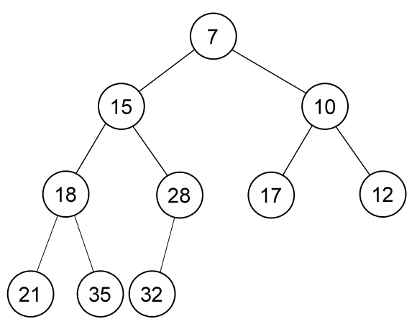
Example of Min-Heap

Slide 7
Heap Applications
Priority Queue
Selection Algorithms (finding min/max element, median, kth-largest element, etc).
Dijkstra’s Algorithm (finding shortest path in graph)
Prim Algorithm (finding minimum spanning tree)
Heap Sort
An O(n.lg(n)) algorithm.

Slide 8
Heap for Priority Queue
Heap is an efficient implementation of priority queue data structure.
find-min : find the smallest element in the heap.
insert : insert a new element into the heap.
delete-min : delete the smallest element from the heap.
delete-min is also called pop, and insert is called push.

Slide 9
Array Implementation
Heaps are usually implemented in an array.
The elements are stored sequentially from index 1 to N from top to bottom and from left to right node of the tree.
Root is stored in index 1
(we let index 0 be blank/unused, for convenience purpose).

Slide 10
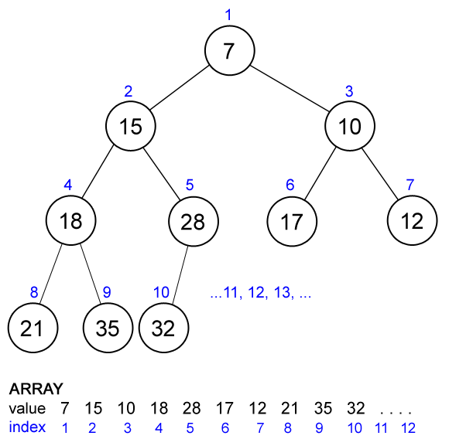
Array Representation

Slide 11
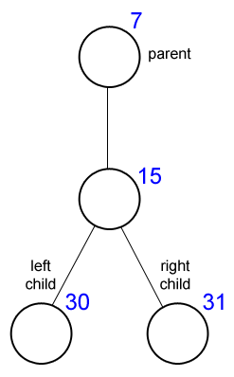
Array Implementation
Each node relation with its parent, left-child and right child in an array implementation can be computed easily.
Let the current node’s index be x.
Parent(x) = x / 2
Left-child(x) = 2 * x
Right-child(x) = 2 * x + 1
This is why we use index 1 as root, otherwise
the relation will not appear as simple as this.

Slide 12
Find-Min in Min-Heap
Find-Min in a min-heap is very easy.
Where is the smallest element in a min-heap located?
ROOT
int findmin() { return data[1]; }

Slide 13
Insertion in Min-Heap
We would like to insert a new element into the heap, but we should maintain its heap property.
Insert the new element at the end of the heap (after the index of the last element).
Upheap the new element (fixing its heap property).

Slide 14
Upheap in Min-Heap
Compare current node’s (start with the inserted node) value with its parent’s value. If the current node’s value is smaller than its parent’s than swap their values and continue upheap the parent node.
Stop if its parent’s value is smaller than current node’s value or current node is the root (has no parent).

Slide 15
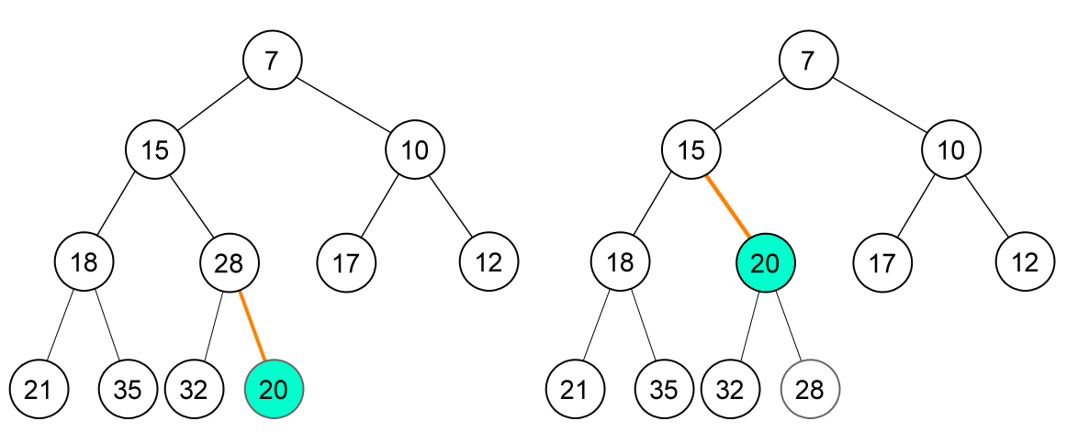
Example of Insertion in Min-Heap
Insert new node (20)

Slide 16
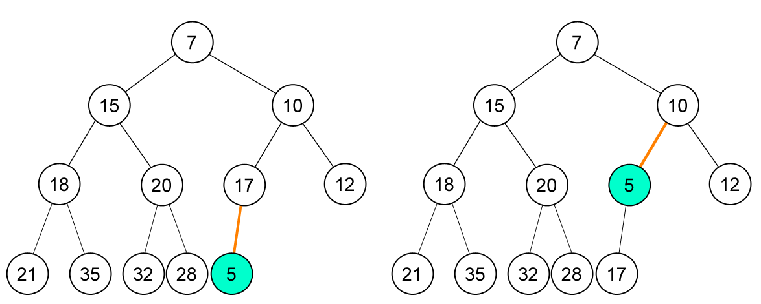
Example of Insertion in Min-Heap
Insert new node (5)

Slide 17
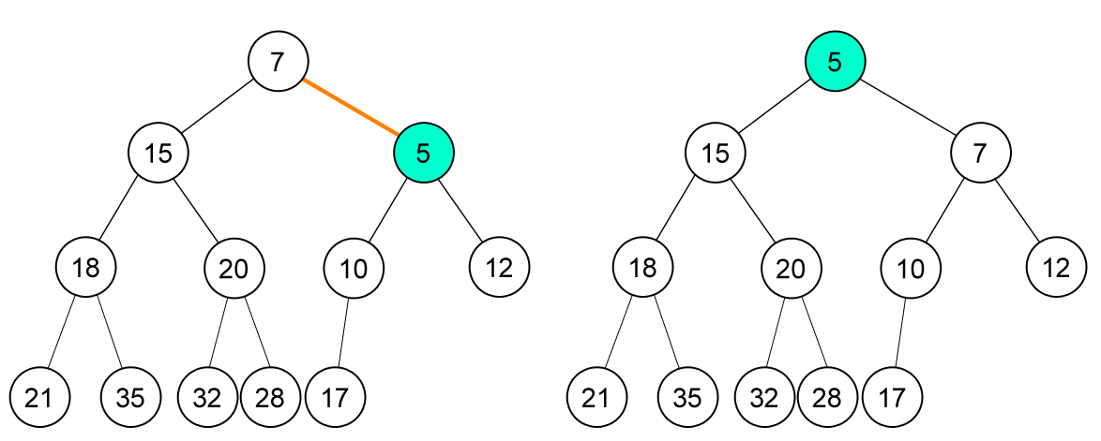
Example of Insertion in Min-Heap
(continue)

Slide 18
Deletion in Min-Heap
Here we only concern with deletion of the smallest element which is located at the root.
Replace root with the last element of the heap.
Decrease the number of element in heap.
Downheap root (fixing its heap property).

Slide 19
Downheap in Min-Heap
Compare current node’s (start with the root) value with its left and right child’s value. Swap current node with its smallest child and continue downheap at that (child) node.
Stop if current node’s value is smaller than both its children’s value or current node is a leaf (has no child).

Slide 20
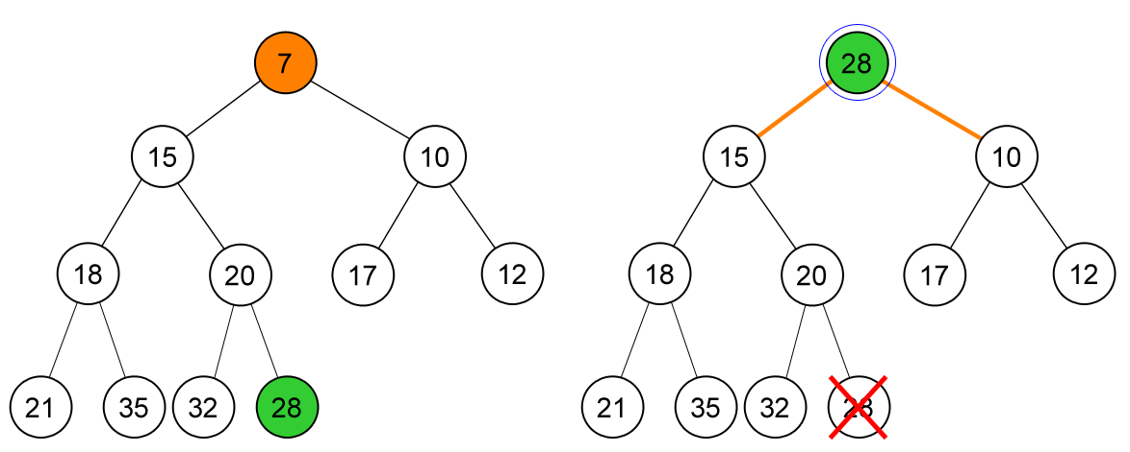
Example of Delete-Min in Min-Heap
Delete-min, node (7)
Replace root with the last element, node (28).

Slide 21
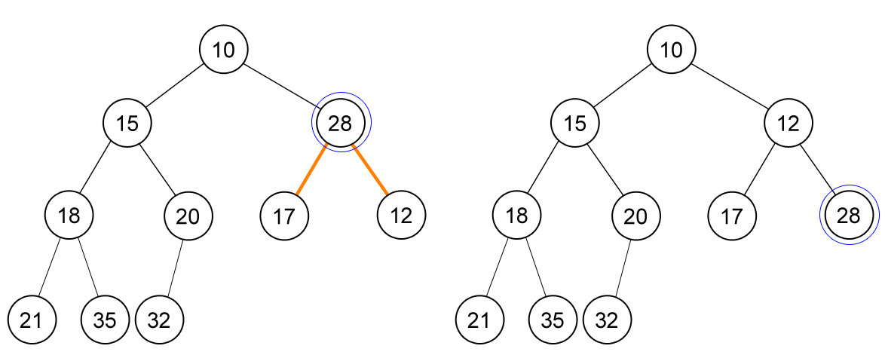
Example of Delete-Min in Min-Heap
(continue)

Slide 22
Heap Complexity
find-min : O(1)
insert : O(log(n))
delete-min : O(log(n))
Insert and delete-min depend on the tree height, which
is log(n), the height of complete binary tree.

Slide 23
Max-Heap
Each node’s element is larger than its children’s element.
It implies that the largest element is located at the root of the tree.
Max-heap holds the same principle as min-heap and can be used to create priority queue which need to find the largest element instead of the smallest one.

Slide 24
Min-Max Heap
The heap condition alternates between minimum and maximum level to level
Each element on even/odd level are smaller than all its children (min-level).
Each element on odd/even level are larger than all its children (max-level).
The purpose of min-max heap is to allow us to find both the smallest and the largest element of the heap at the same time.

Slide 25
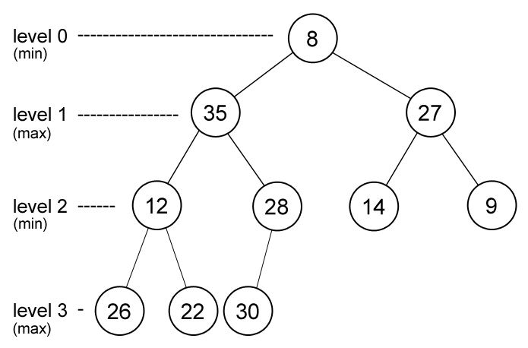
Min-Max Heap

Slide 26
Min-Max Heap
In min-max heap,
The smallest element is located at the root.
The largest element is located in one of the root’s child (either left/right child).
Note: the largest element may be located at root if there is only one element in the heap.
findmin() { return data[1]; }
findmax() { return max(data[2], data[3]); }

Slide 27
Insertion in Min-Max Heap
Insert the new element at the end of the heap (after the index of the last element).
Upheap the new element (fixing its heap property).
Upheap in min-max heap is a bit different with min-heap or max-heap.

Slide 28
Upheap in Min-Max Heap
If the new node is on a min-level
If new node’s parent is smaller than it then swap their value and upheapmax from its parent.
Else upheapmin from the new node
If the new node is on a max-level
If new node’s parent is larger than it then swap their value and upheapmin from its parent.
Else upheapmax from the new node

Slide 29
Upheapmin/max in Min-Max Heap
Upheapmin
Compare current node’s value with its grand-parent’s value. If
the current node’s value is smaller than its parent’s than swap
their values and continue upheapmin the grand-parent node.
Upheapmax
Compare current node’s value with its grand-parent’s value. If
the current node’s value is larger than its parent’s than swap
their values and continue upheapmax the grand-parent node.

Slide 30
Min Max Heap Insert 50
8
Upheapmin : 50 is larger than its parent, so do upheapmax
Upheapmax : 50 is larger than its grand-parent, so swap their value
35
27
12
28
14
9
26
22
30
50

Slide 31
Min Max Heap Insert 50
8
Upheapmax : because node 50 doesn’t have grand-parent, the process is finished
50
27
12
28
14
9
26
22
30
35

Slide 32
Min Max Heap Insert 5
8
Upheapmin : node 5 is smaller than its parent, so swap their value and continue upheapmin
50
27
12
28
14
9
26
22
30
35
5

Slide 33
Min Max Heap Insert 5
8
Upheapmin : node 5 is smaller than its grand-parent, so swap their value and continue upheapmin
50
27
12
28
5
9
26
22
30
35
14

Slide 34
Min Max Heap Insert 5
5
Upheapmin : because node 5 doesn’t have grand-parent, the process is finished
50
27
12
28
8
9
26
22
30
35
14

Slide 35
Deletion in Min-Max Heap
Deletion of the smallest element
Replace root with the last element in heap.
Decrease the number of element in heap.
Downheapmin from root.
Deletion of the largest element
Replace either left-child or right child of root (depends on which one is larger) with the last element in heap.
Decrease the number of element in heap.
Downheapmax from the node.

Slide 36
Downheapmin/max in Min-Max Heap
Downheapmin
Let m is the smallest element in current node’s children and grandchildren (if any).
If m is grandchildren of current node then
If m is smaller than current node then
Swap their value
If m is larger than its parent then swap their value
Continue downheapmin from m
If m is children of current node then
If m is smaller than current node then
Swap their value
Downheapmax is the same except that the relational operators are reversed.

Slide 37
Min Max Heap Delete Max
5
Replace the max value and replace it with last node (14)
50
27
12
28
8
9
26
22
30
35
14

Slide 38
Min Max Heap Delete Max
5
Downheapmax : find the largest value from its children and grand-children. After that, swap their value.
14
27
12
28
8
9
26
22
30
35

Slide 39
Min Max Heap Delete Max
5
Downheapmax : because 14 parents is larger than 14, swap their value and continue downheapmax.
35
27
12
28
8
9
26
22
30
14

Slide 40
Min Max Heap Delete Max
5
Because 28 doesn’t have children or grand-children, the process is finished
35
27
12
14
8
9
26
22
30
28

Slide 41
Applications of Heaps
Heaps are preferred for applications that include:
Heap sort
it is one of the best sorting methods that has no quadratic worst-case scenarios
Selection algorithms
these algorithms are used to find the minimum and maximum values in linear or sub-linear time
Graph algorithms
Heaps are therefore used for implementing Prim’s minimal spanning tree algorithm and Dijkstra’s shortest path problem

Slide 42
Tries Concept
Tries (prefix tree) is an ordered tree data structure that is used to store an associative array (usually strings)
The term TRIE comes from word RETRIEVAL, because tries can find a single word in a dictionary with only a prefix of the word.

Slide 43
Application of Tries
Do you know how the web browser can auto complete your text or show you many possibilities of the text that you could be writing?
Do you know how a spell checker can check that every word that you type is in a dictionary?
Do you know how a spell checker can suggest a correction of a mistyped word?

Slide 44
Tries
Tries is a tree where each vertex represents a single word or a prefix.
The root represents an empty character (‘’).
A vertex that are k edges of distance from the root have an associated prefix of length k.
Let a and b be two vertices of the tries and assume a is a direct parent of b, then b must have an associated prefix of a.

Slide 45
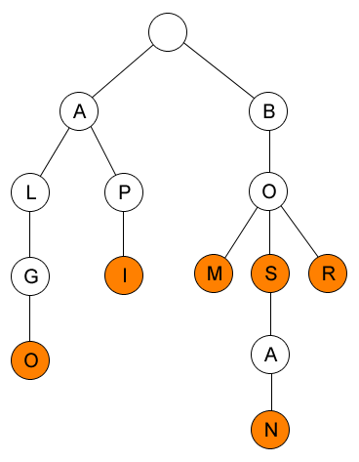
Example of Tries
Example of a tries that
contains words:
ALGO
API
BOM
BOS
BOSAN
BOR

Slide 46
Tries Structure
We can use this structure to implement tries:
struct trie {
char chr;
int word;
struct trie* edge[128];
} *root = 0;
root = (struct trie*)malloc(sizeof(struct trie));
root->chr = ‘’;
root->word = 0;
chr is the character stored in that node.
word is 1 if there is a word ends at this node, 0 otherwise.

Slide 47
Insertion in Tries
To insert a word into a tries, we can use this code:
void insert(struct trie *curr, char *p) {
if ( curr->edge[*p] == 0 )
curr->edge[*p] = newnode(*p);
if ( *p == 0 ) curr->word = 1; else insert(curr->edge[*p],p+1);
}
main function
char s[100];
insert(root, s);

Slide 48
Insertion in Tries
newnode() function
struct trie* newnode(char x) {
struct trie* node =
(struct trie*)malloc(sizeof(struct trie));
node->chr = x;
node->word = 0;
for (i = 0; i < 128; i++ )
node->edge[i] = 0;
return node;
}

Slide 49
Finding in Tries using Prefix
Supposed we want to find all strings in tries that have a certain prefix.
char s[100] = {“...”}; // global
int i, n, okay;
struct trie *curr;
n = strlen(s);
okay = 1;
curr = root;
for ( i = 0; i < n && okay == 1; i++ )
if ( curr->edge[s[i]] == 0 ) okay = 0;
else curr = curr->edge[s[i]];
if ( okay ) find(curr,n);
First, we should locate the last character (s/prefix) location in the tries.

Slide 50
Finding in Tries using Prefix
and the find function (it will print all strings which have the prefix)
void find(struct trie *curr, int x) {
if ( curr->word == 1 ) {
s[x] = 0;
puts( s );
}
for ( i = 0; i < 128; i++ )
if ( curr->edge[i] != 0 ) {
s[x] = i;
find(curr->edge[i],x+1);
}
}

Slide 51
Hashing
Hashing is a transformation of a string of characters into a usually shorter length value or key that represents the original string.
Hashing is used to index and retrieve items in a database because it is faster to find item using shorter hashed key than to find it using the original value.

Slide 52
Hash Table
Hash table is a table (array) where we store the original string. Index of the table is the hashed key while the value is the original string.
The size of hash table is usually several orders of magnitude lower than the total number of possible string, so several string might have a same hashed-key.
For example, there are 26⁷ (8,031,810,176) string of length 7 consists of lowercase only.

Slide 53
Example
Consider this example.
Supposed we want to store 5 string: define, float, exp,
char, atan into a hash table with size 26. The hash
function we will use is “transform the first character of
each string into a number between 0..25”
(a will be 0, b will be 1, c will be 2, …, z will be 25).

Slide 54
Example
This is the hash table
of those string.
atan is stored in h[0] because a is 0.
char is stored in h[2] because c is 2.
define is stored in h[3] because d is 3.
and so on..
We only consider the first character
of each string.
h[ ] | Value
0 | atan
1
2 | char
3 | define
4 | exp
5 | float
6
…
25

Slide 55
Hash Function
There are many other ways to hash a string into a key.
Mid-square
square the string/identifier and then using an appropriate number of bits from the middle of the square to obtain the hash-key.
Division (most common)
divide the string/identifier by using the modulus operator.
Folding
Partition the string/identifier into several parts, then add the parts together to obtain the hash key.

Slide 56
Collision
What happened if we want to store these strings using the
previous hash function (use the first character of each string)
define, float, exp, char, atan, ceil, acos, floor.
There are several strings which have the same hash-key, it’s
float and floor (hash-key: 5), char and ceil (hash-key: 2).
It’s called a collision. How can we handle this?

Slide 57
Collision
There are two general ways to handle collisions:
Linear Probing
Search the next empty slot and put the string there.
Chaining
Put the string in a slot as a chained list (linked list).

Slide 58
Linear Probing
This is the hash table of these string:
define, float, exp, char, atan,
ceil, floor, acos.
Note that ceil is stored in h[6], acos is
stored in h[1] and floor is stored in h[7].
When we want to store “ceil”, there is
already “char” stored in h[2], so we
search the next empty slot which is h[6].
h[ ] | Value
0 | atan
1 | acos
2 | char
3 | define
4 | exp
5 | float
6 | ceil
7 | floor
…

Slide 59
Linear Probing
Linear probing has a bad
search complexity if there are
many collisions.
The table “step” on the right
describe how many loop/step
needed to find the string.
Supposed we want to find ceil,
we compute the hash key and found
2. But ceil is not there so we should
iterate until we found ceil.
h[ ] | Value | Step
0 | atan | 1
1 | acos | 2
2 | char | 1
3 | define | 1
4 | exp | 1
5 | float | 1
6 | ceil | 5
7 | floor | 3
…

Slide 60
Linear Probing
void linear_probing(item, h[]) {
hash_key = hash(item);
i = has_key;
while ( strlen(h[i] != 0 ) {
if ( strcmp(h[i], item) == 0 ) {
// DUPLICATE ENTRY }
i = (i + 1) % TABLE_SIZE;
if ( i == hash_key ) {
// TABLE IS FULL } }
h[i] = item; }

Slide 61
Chaining
In chaining, we store each
string in a chain (linked list).
So if there is collision, we only
need to iterate on that chain.
h[ ] | Value
0 | atan → acos
1 | NULL
2 | char → ceil
3 | define
4 | exp
5 | float → floor
6 | NULL
7 | NULL
…

Slide 62
Chaining
void chaining(item, h[]) {
hash_key = hash(item);
trail = NULL, lead = h[hash_key];
while ( lead ) {
if ( strcmp(lead->item, item) == 0 ) { // DUPLICATE ENTRY }
trail = lead; lead = lead->next; }
p = malloc new node;
p->item = item;
p->next = NULL;
if ( trail == 0 ) h[hash_key] = p; else trail->next = p;
}

Slide 63
Summary
Heap is a complete binary tree based data structure that satisfies heap property
Heap is much easier to implement by using array
Heap is an efficient implementation of priority queue data structure.
Deap is a double ended heap
Deap can be used to find the smallest and the largest element in a heap
Each node in left-sub-tree has its corresponding node in the right-sub-tree

Slide 64
Summary
Leftist Tree is a variant of heap which can find the smallest or largest element in the tree
A binary tree is a leftist tree if at every internal node the s value of the left child is greater than or equal to the s value of the right child.
Tries (prefix tree) is an ordered tree data structure that is used to store an associative array (usually strings)
The term TRIE comes from word RETRIEVAL

Slide 65
Summary
Hashing is a transformation of a string of characters into a usually shorter length value or key that represents the original string
Hashing is used to index and retrieve items in a database
Hash table is a table (array) where we store the original string
Two general ways to handle collisions: Linear Probing and Chaining

Slide 66
References
Reema Thareja,. 2014. Data structures using C. OXFOR. New Delhi. ISBN:9780198099307 Chapter 11, 12 & 15
Min Heap
http://www.cs.usfca.edu/~galles/visualization/Heap.html

Slide 67
END
Heap and Deap

